Slide 1

Service to test web applications in a sanitized cloud environment.
We tried to automate everything!
Lisa Blackerby Sam Riley Adam Sturchio
In Collaboration with: Ashley Mains Warnitris May

Slide 2
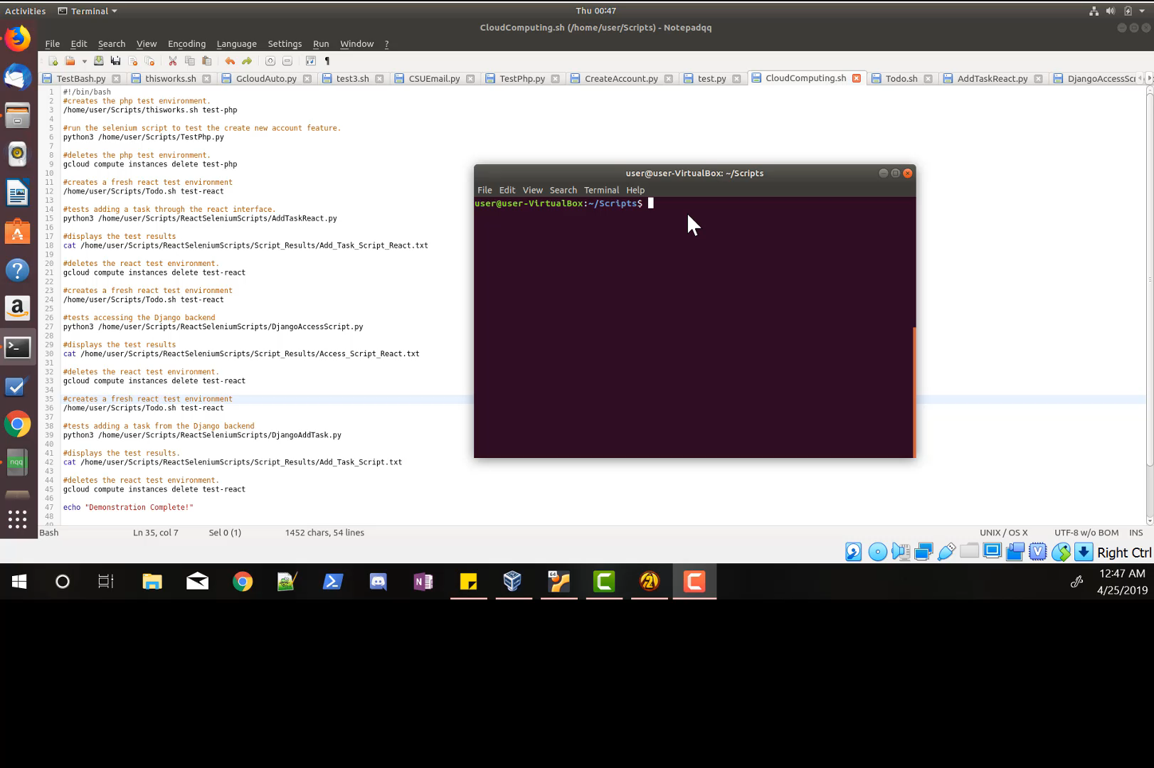
Let’s see it in action

Slide 3
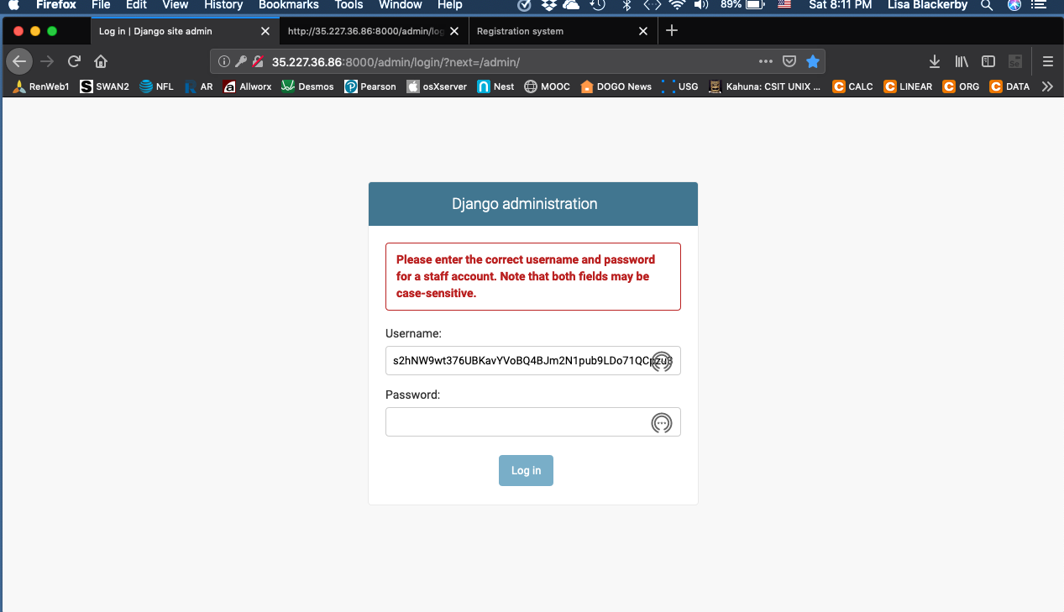
Lisa tried to break in to the sites Using sql Injection

Slide 4
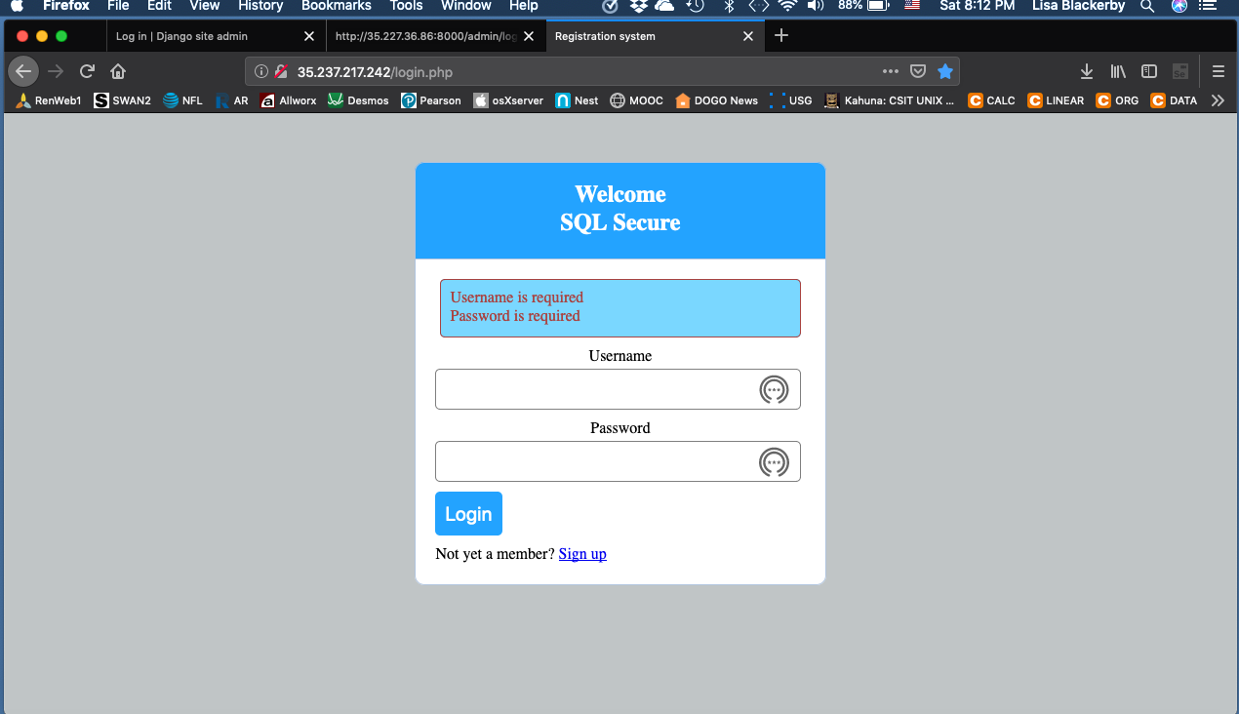
But the site was too secure!

Slide 5
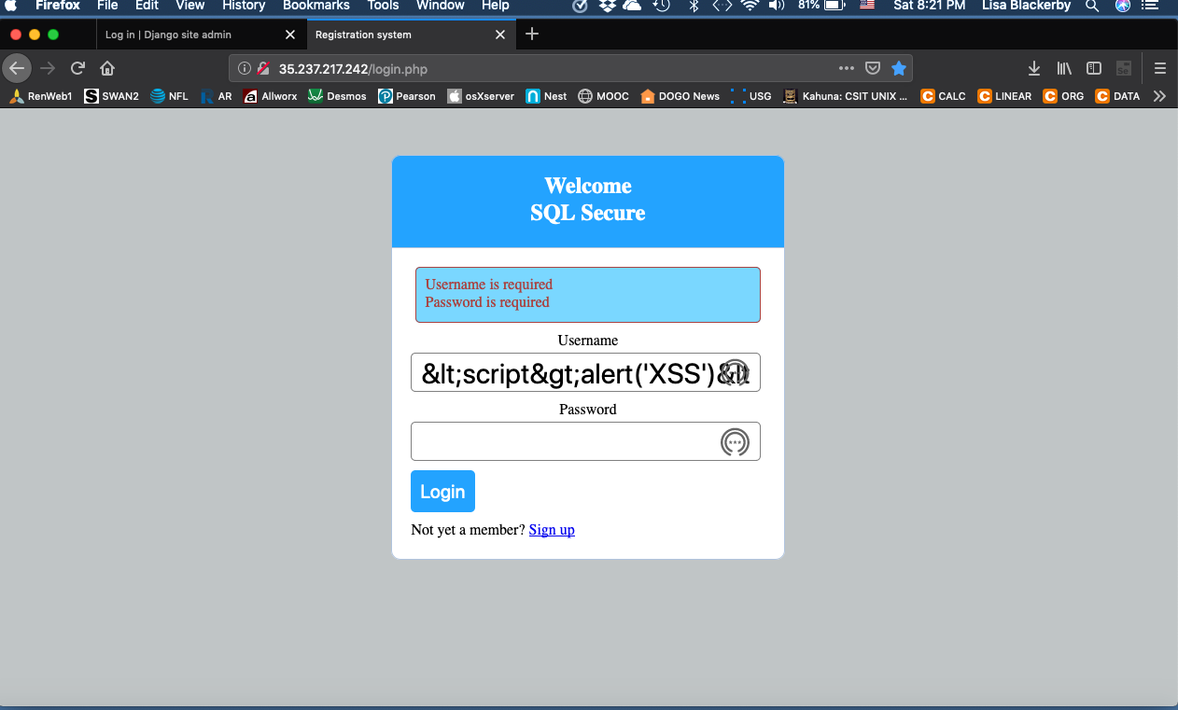
She tried a few other things

Slide 6
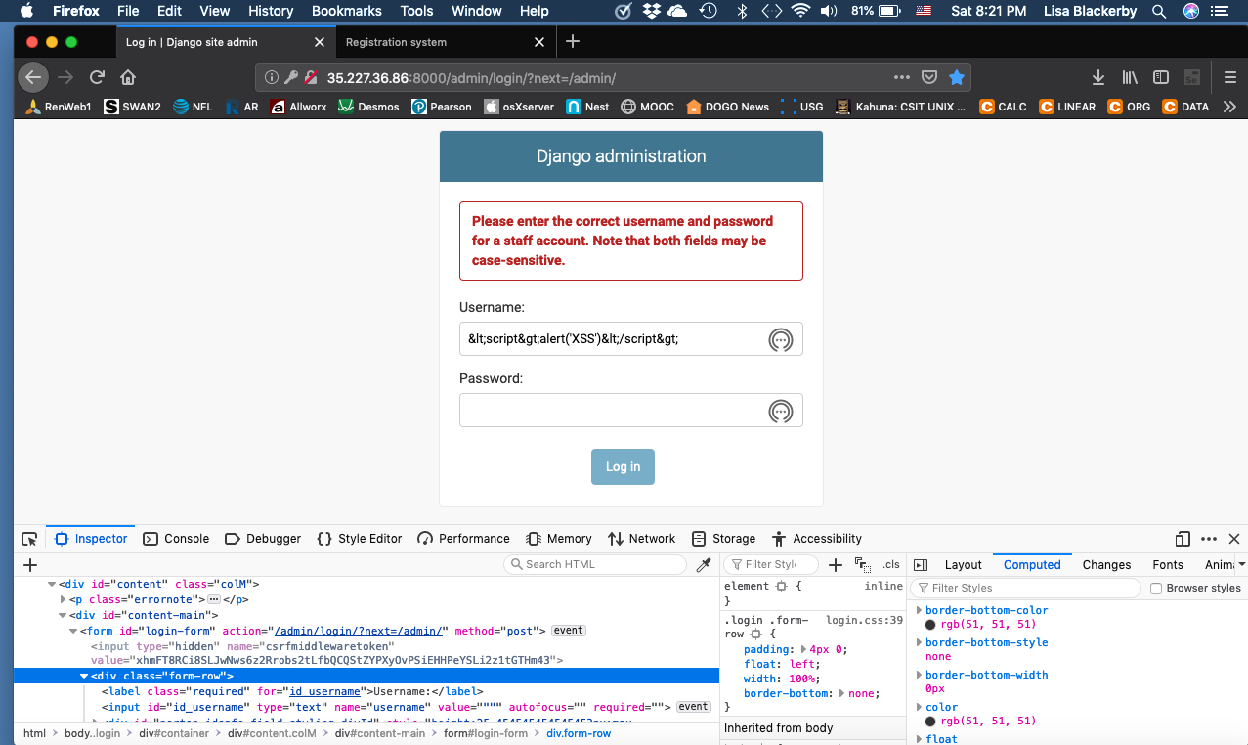
Maybe this one…

Slide 7
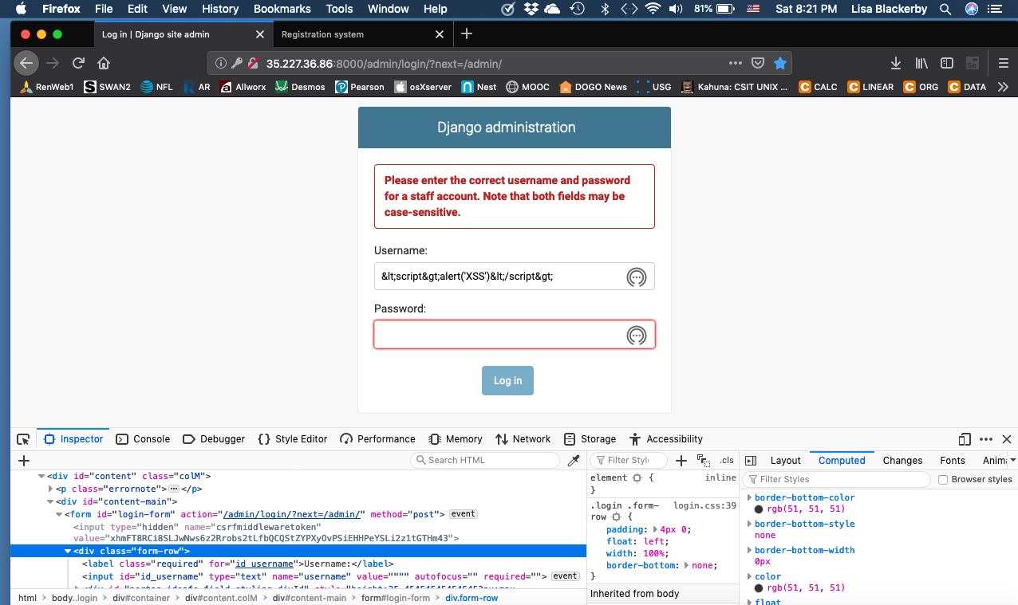
Or this one…

Slide 8
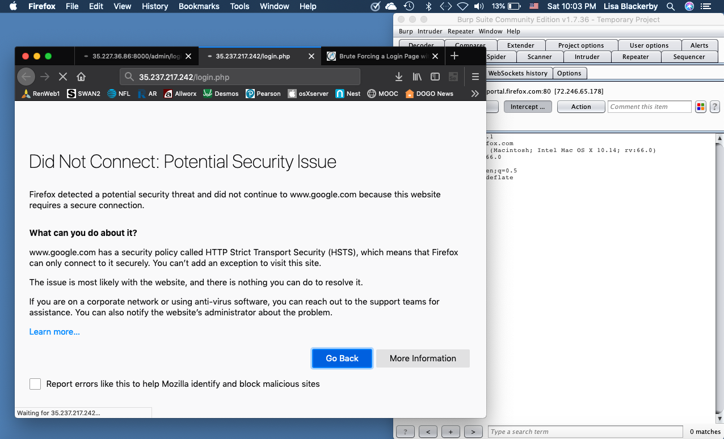
How bout burp suite!

Slide 9
Looks like this one passed all of the sql injection tests.

Slide 10
Questions?

